Slide 1


The world’s leading AI-powered developer platform
Pedro Lacerda Senior Solutions Engineer @ GitHub
Leandro Prado
Cloud Solution Architect @ Microsoft
Notes:
GitHub is the world’s most trusted and adopted AI-powered developer platform, empowering organizations to build, secure, and ship software faster to unlock innovation at scale. The complete platform is backed by Microsoft and home to 100 million developers, offering natively-embedded, enterprise-grade tools like CI/CD and automation, application security testing, collaborative cloud development environments, collaboration tools, and AI making it easy to quickly deliver secure software. Purpose-built with integrated toolchains and workflows, GitHub is the world’s leading developer platform that reduces context switching, increases collaboration, and eliminates barriers so teams can build, scale, and deliver secure software fast.

Slide 2

1 security team member for every 100 developers.
Only 10% of companies have figured out how to use AI in their organizations.
52% of developers say they work with other teams daily or weekly.
Source: Verizon Data Breach Investigations reports 2016, 2017, 2018, 2019 and 2020
Source: McKinsey, 2021
Source: GitHub
DevOps Today
Lost Productivity
Security Risks
Missed Opportunities
Developers rank collaboration as a top priority, over code quality.
Flaws in applications are the #1 attack vector.
Companies are not equipped to fully realize the power of AI.
Notes:
Companies across the globe rely on DevOps to fuel growth and drive innovation. However, DevOps is a complex landscape. There are countless tools that don’t always work together resulting in disjointed integrations and uncontrolled operating costs. We hear about concerns with data security and risk in what gets shipped as companies work across so many tools. And all the while no one wants to miss out on the latest developments in AI as it changes the industry at a tremendous speed. It’s a lot to deal with. And it leads to a huge pain point for companies in terms of lost productivity, unsustainable processes and workflows, and high operating costs.
UCI report in this article (23 minutes switching between tools): https://www.hatica.io/blog/context-switching-killing-developer-productivity/
GitHub: https://github.blog/2023-06-13-survey-reveals-ais-impact-on-the-developer-experience/#developers-want-more-opportunities-to-upskill-and-drive-impact
McKinsey report https://www.mckinsey.com/industries/technology-media-and-telecommunications/our-insights/tipping-the-scales-in-ai

Slide 3

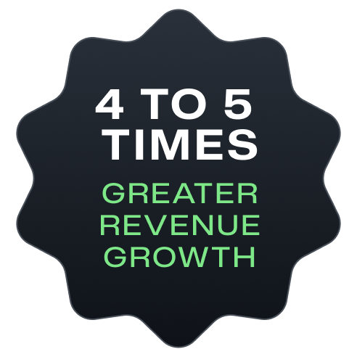
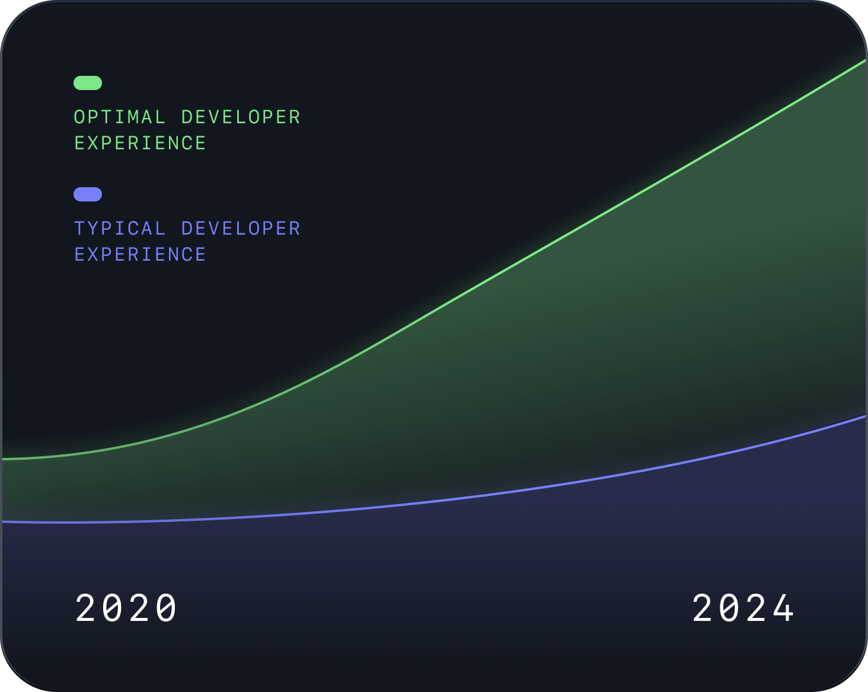
DevOps Today / Developer Experience
Experience
makes the difference.
A McKinsey study found that companies with better developer work environments achieved revenue growth 4 to 5 times greater than their competitors.
Notes:
One pain point is often overlooked: All of these issues create a poor developer experience.
But at GitHub, we believe experience makes the difference.
A strong focus on the optimal experience for the developer provides more time and energy for teams to focus on creative solutions to the world's problems, leading to more innovation. Furthermore, it increases employee productivity and retention, which leads to faster ships. All of which combines to dramatically improve a company's bottom line.
Added notes:
DevEx the way of the future - seen as "Very" or Extremely" critical by leaders - https://www.gartner.com/en/newsroom/press-releases/2023-04-24-gartner-survey-finds-the-need-to-improve-developer-experience-is-driving-software-engineering-technology-adoption
"A 2020 McKinsey study found that companies with better work environments for their developers achieved revenue growth four to five times greater than that of their competitors.13" https://queue.acm.org/detail.cfm?id=3595878
At GH we can influence all three areas that impact devx (https://queue.acm.org/detail.cfm?id=3595878):
create faster feedback loops
decrease cognitive load
Increase flow state

Slide 4




The GitHub experience
A single integrated enterprise-ready platform
Security at every step of the workflow
Industry-best collaborative tools for developers
Powered By AI
Notes:
How do we help you unlock these benefits? By offering a single integrated, enterprise-ready platform with industry best collaborative tools, security features wrapped in every step of the development process, and the power of AI supercharging every interaction so your developers can move quickly, efficiently, and confidently.

Slide 5
Appendix / Insights and Data
…and backed by the world’s largest software company
100M+
4M+
330M+
90%
Registered Users
Organizations
Repositories
Fortune 100
Notes:
+ 330M repos: https://github.com/about
4M+ organisations: https://github.com/customer-stories?type=enterprise
100M+ registered users + 90% fortune 100 companies sources: https://resources.github.com/devops/tools/compare/

Slide 6




Copilot
Collaboration
Pull requests
Projects
Issues
Discussions
Merge queue
Search
Productivity
CI/CD with Actions
Automation
Copilot
Codespaces
Runners
npm
Mobile
Security
Advanced Security
Secret scanning
Code scanning
Security overview
Supply chain
Dependabot
Scale
Integrations & APIs
100M+ developers
Source code management
Notes:
Let’s take a look at how it all comes together in GitHub Platform: the AI-powered developer platform, globally available, secure by default.
GitHub Platform focuses on the developer experience–it has the scale to provide industry-changing insights, collaboration capabilities for transformative efficiency, the tools for increased productivity, security at every step, and AI to power it all to new heights in a single, integrated platform.
GitHub has the unique opportunity to do all of the above, allowing you to do more through a single integrated developer experience platform.
VALUE PROP HERE: GitHub Enterprise, the one single developer experience. Powered by AI and secure at every step. Helping your teams be more productive, collaborative, and efficient.
GitHub has the unique opportunity to do all of the above, plus transform your business through a single developer experience platform. When speaking with thought leaders, executives, and the C-suite, companies care about the production side of their business to ship faster and more securely.
But GitHub has the unique advantage to additionally transform businesses through a cultural shift. GitHub is loved by developers, and is built on the data of 100+ million developers. With all this data, we have the unique opportunity to understand what the best developer experience is, while upholding our strong brand for all developers who use GitHub for the first time in school, as a hobby, or even to just learn.
How does it all fit together? GitHub Enterprise contains 3 core pillars where we are continuing to make investments: collaboration, automation, security, and powered by AI that runs through the platform. With AI coming to all areas of GitHub, you will be able to use all the best features of GitHub, but with even greater simplicity. (this sentence also might need work…)

Slide 7
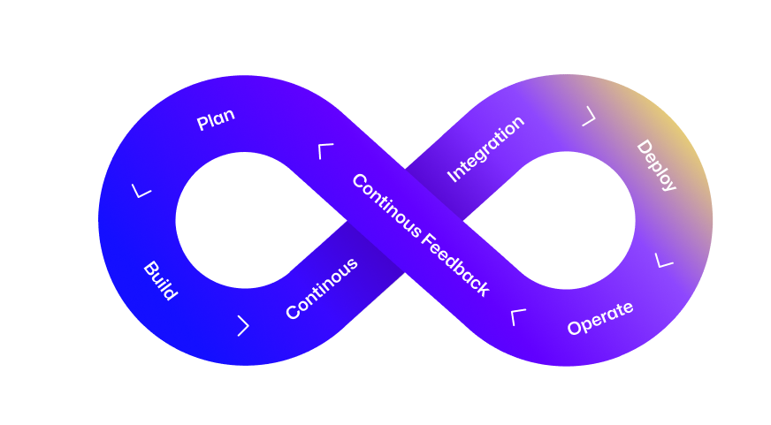
Appendix / Challenges + Use Cases
Consolidated Efficiency
Driving 433% ROI with GitHub Enterprise
Seamless Integration + stack alignment
<6 months’ payback After go-live
Developer efficiency
22% improvement In developer productivity
80% time saved In developer onboarding
Maintenance and overhead
75% improvement In time spent managing tools and code infrastructure
Notes:
WIP Talk track: Many organisations we speak with are looking to reduce the complexity in their tool stacks - whether that is companies needing to downsize, reduce their TCO (total cost of ownership), or simply preferring to use one tool due to efficiency. Too many tools lead to a myriad of problems. It’s harder to onboard new devs and have them ramp, it’s harder for inter-team and intra-team collaboration leading to longer release cycles, and even just managing multiple vendors and the admin associated with that is time consuming. However, you do not want to fall into the trap of reducing capability alongside complexity reduction. With GitHub that is not a problem. We are uniquely positioned to enable you to expand your DevSecOps capabilities while using a single integrated platform.
Stats
22% improvement In developer productivity
75% improvement In time spent managing tools and code infrastructure
<6 months’ payback After go-live
80% time saved In developer onboarding
Reference: https://resources.github.com/forrester/

Slide 8
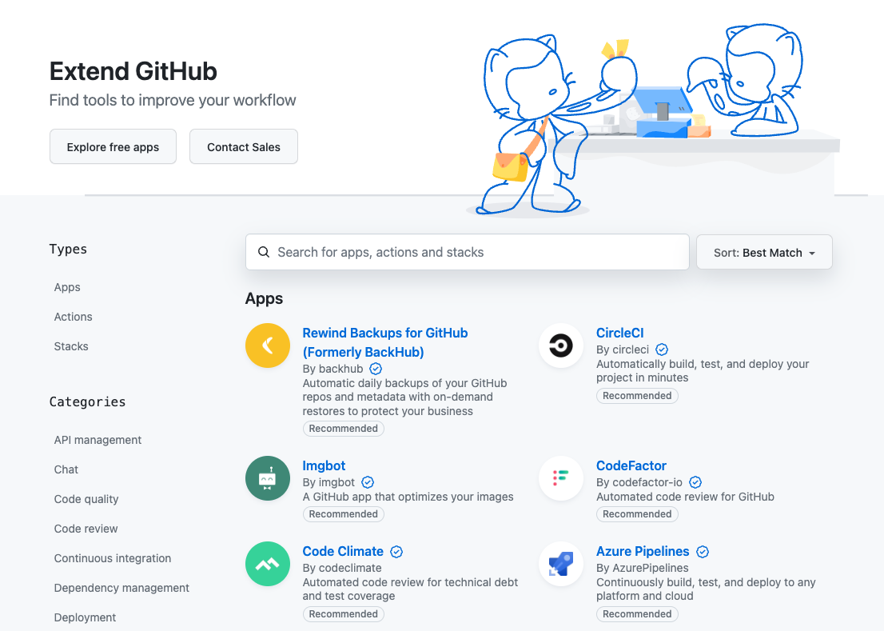
Appendix / Challenges + Use Cases
Seamless Integration
799+ Marketplace integrations
Leverage the industry’s most flexible secure development platform
Support all your favorite programming languages and frameworks, databases, mobile development platforms, cloud platforms, and incorporate any of over 19,000 community and enterprise contributed Actions modules into your workflows.
Notes:
We have 799+ integrations to build on your workflow with apps that integrate with GitHub. Want more info on our integration? Have a look at https://github.com/marketplace?category=&query=sort%3Apopularity-desc&type=apps&verification=
GitHub Platform: Work with issues, pull requests, checks, releases and more.
GitHub CLI: Work with issues and pull requests directly from the command line
Script and customize with GitHub APIs

Slide 9

Appendix / GitHub Partners
800+ GitHub Partners
Work with one of our official partners to give your team the tools and know-how you need to be successful on GitHub.
Let us help you find the one for you
DevSecOps Industry Expertises + AI
Migration Services
Accelerate Adoption + Value of GitHub
Optimisation, Performance + Scale
Workflow Consultation
Security & Governance
Global Systems Integrators Microsoft Partner Ecosystem Regional Systems Integrators Specialised Consulting
Training
Notes:
GitHub seeks to transform the way software is built, deployed, and maintained. Effective DevOps isn’t just a set of tools. It’s a combination of technology, culture, and process change.
With over 800 partners globally (that collaborate with us from API integrations to selling and providing consultancy services) we can help ensure your every need is met, and you can adopt GH as quickly and efficiently as possible
We have Partners that can:
1) Provide offerings and solutions for digital transformation, code to cloud, cloud and industry expertise and technology integration guidance and services.
2) Bring deep skills across our product family to help you leverage these new sophisticated offers.
3) Accelerate adoption and deployment by helping them migrate to GitHub, scale and customize their environment. 4) Help overcome procurement barriers by acting as distributors or resellers For you, I’d love to recommend _________ [seller’s suggestion]. I believe they would be able to help you with _________ [seller’s suggestion].

Slide 10




Notes:
Experience really does make the difference. And using the depth and breadth of our experience as the largest developer space on the planet, we built the GitHub platform to surpass expectations of what’s possible in software development tomorrow and meet the challenges of DevOps today.

Slide 11
Empowering Enterprises
GitHub provides the resources businesses need to innovate and scale effectively, tackling the productivity paradox by creating more time to rapidly innovate, scale, and maintain a competitive advantage in their respective markets.
Notes:
Example talk track:
Our first principle is “Empowering Enterprises”
In our rapidly evolving digital landscape, the success of large-scale organizations in software development is not just beneficial but essential. GitHub understands this and has tailored its platform to meet these unique enterprise needs. But empowering enterprises isn’t just about providing a great experience for some of the largest companies. It’s about giving startups and mid size companies the tools they need to scale and grow their business, helping them to become enterprise companies.
By equipping enterprises with AI-powered tools and integrations, GitHub ensures organizations are on the leading edge of the productivity polarity, where they can rapidly innovate, scale, and maintain a competitive advantage in their respective markets.
Extra talk track:
Let's start with security, a cornerstone of GitHub's enterprise strategy. In recognizing the critical need for stringent security measures, GitHub offers advanced features specifically designed for enterprises. This includes automated vulnerability scanning and secure coding practices, ensuring that enterprise projects are safeguarded against the latest threats. Security isn't just a feature; it's a foundational element, enabling enterprises to innovate with confidence.
Collaboration is another key pillar. GitHub breaks down geographical and departmental barriers, enabling seamless interaction across global teams. With tools that streamline code reviews and foster effective team discussions, GitHub transforms collaboration from a challenge into a significant asset for enterprise-scale software development.
Next, we address scalability. GitHub's infrastructure is built to handle the demands of large organizations, accommodating growth without sacrificing performance. Whether dealing with massive data volumes or coordinating across hundreds of developers, GitHub ensures that your enterprise's scalability needs are met.
Customization and integration play critical roles as well. GitHub recognizes that no two enterprises are the same, offering a platform that adapts to your specific workflows and integrates seamlessly with your existing tools and systems. This level of customization ensures that your enterprise can maintain its unique processes while benefiting from GitHub's powerful features.
Lastly, GitHub empowers enterprises through dedicated training and support. Understanding the full capabilities of GitHub's platform is paramount. With specialized training programs and priority support, enterprises can quickly leverage the full power of GitHub, ensuring teams are equipped to tackle the complexities of modern software development.

Slide 12
Enhancing the Developer Experience
Improving the developer experience with AI tools like GitHub Copilot addresses the productivity paradox by boosting developer efficiency and satisfaction. When teams collaborate more effectively and modernize their workflows, enterprises unlock productivity gains.
Notes:
Talk Track:
Our second principle, "Enhancing the Developer Experience," is fundamental in the dynamic world of software development. At GitHub, we are dedicated to transforming the everyday workflow of developers into a more productive, engaging, and fulfilling journey. By leveraging AI tools like GitHub Copilot, we address the "productivity paradox," significantly enhancing developer efficiency and satisfaction. This ensures that teams work smarter and more efficiently, not just harder.
Extra talk track:
How do we achieve this enhanced experience? We start by streamlining development workflows, reducing friction, and accelerating innovation. GitHub Actions and Copilot automate routine tasks, freeing developers to focus on creating exceptional software. Collaboration is central to our strategy, fostering an inclusive environment where every team member's ideas are valued and every voice can be heard, through pull requests, discussions, and reviews.
Furthermore, GitHub is not just a platform for code; it's a community for growth. Developers gain access to a vast network of open-source projects and continuous learning opportunities, expanding their skills and contributing to the broader ecosystem. We prioritize intuitive tools and seamless integrations, ensuring a user-friendly interface and easy access to essential services, which minimizes context switching and streamlines the development process.
Our commitment to enhancing the developer experience is also evident in our feedback-driven approach. By actively listening to the community and adapting to the needs of developers, we continuously introduce innovations that make software development not only more effective but also more enjoyable. This roadmap presentation exemplifies our transparency, keeping you informed and engaged with our latest developments as we enhance the developer experience across the globe.

Slide 13
Security at Every Step
As security demands escalate and threats grow more sophisticated, organizations must adopt AI-powered security solutions to navigate the productivity paradox, ensuring security moves at the speed of innovation.
Notes:
Talk track:
GitHub underscores its principle of "security at every step" through a suite of integrated features aimed at enhancing code security and the platform's robustness. Through tools like Dependabot, which automates the detection and resolution of vulnerabilities in dependencies, and Code Scanning that proactively identifies security flaws within the codebase, GitHub facilitates a secure development environment. Additionally, Security Advisories allow for the discreet handling and resolution of vulnerabilities, ensuring issues are managed responsibly before public disclosure.
Extra talk track:
The platform fortifies user and data security through mandatory two-factor authentication (2FA), stringent security policies, and advanced infrastructure protection measures. These include encryption of data in transit and at rest, safeguarding against unauthorized access and potential security threats. GitHub's commitment extends to compliance with leading industry standards and certifications, ensuring adherence to global security and privacy regulations, thus maintaining a trusted environment for its vast user base.
In its pursuit of continuous improvement and transparency, GitHub operates with a proactive stance on security incident response, ready to tackle vulnerabilities and breaches with a dedicated team. The publication of transparency reports, detailing responses to government takedown requests, underscores GitHub's dedication to user privacy and the open source community's security. This multifaceted approach to security at every step not only emphasizes GitHub's commitment to safeguarding its platform but also empowers developers to prioritize security within their development workflows.

Slide 14
The GitHub Roadmap
Upcoming Releases
Notes:
Talk Track:
You’ll see these themes woven throughout our roadmap. You can think of ways that each of our outcomes, and at a micro level each release, maps up to them. This strategy ensures that we’re constantly improving some part of the experience for our users, in order to ensure

Slide 15
Productivity Paradox
and our
Innovation Principles
Notes:
Earlier you heard about the concepts of “productivity paradox” and “product polarity”, which speaks to the significant divide in productivity and innovation between those who embrace cutting-edge technologies and methodologies and those who do not.
At GitHub, we strive to help our users stay at the forefront of productivity and innovation, by providing equipping them with the latest technologies to stay at the cutting edge of productivity polarity. In order to achieve this, we have our core innovation strategy. This strategy comprises of three guiding principles: Empowering Enterprises, Enhancing the Developer Experience, and Security at Every Step
As we build, we think about how each feature, no matter how small, ladders up to one of these principles. Now right off the bat you may be thinking, can’t a feature fall into multiple categories? Of course they can, there are certain features that fall into all three. The important thing here is that if a feature isn’t falling into any of these categories, than it’s probably worth asking the question why we are building it in the first place? These principles help ensure that we’re focused on outcomes, not features, as we enhance the GitHub platform.
Let’s talk a bit more about these themes, how they relate to the concepts you heard about earlier, and look at an example of a release from this year that ladders up to these themes.

Slide 16



Our Guiding Principles
Empowering Enterprises
Security at
Every Step
Enhancing the Developer Experience
Notes:
Talk Track:
Our innovation strategy comprises of three guiding principles: Empowering Enterprises, Enhancing the Developer Experience, and Security at Every Step
As we build, we think about how each feature, no matter how small, ladders up to one of these principles. Now right off the bat you may be thinking, can’t a feature fall into multiple categories? Of course they can, there are certain features that fall into all three. The important thing here is that if a feature isn’t falling into any of these categories, then it’s probably worth asking the question why we are building it in the first place? These principles help ensure that we’re focused on outcomes, not features, as we enhance the GitHub platform.

Slide 17
Move Fast Safely
Notes:
Talk Track:
Now let’s talk about a problem that many of you may be familiar with. In modern software development, we often have to weigh moving fast against the ability to move safely. GitHub offers both, bringing features like enterprise grade control and flexible governance to a platform built to automate repetitive tasks and boost developer productivity.

Slide 18

Optimize Operational Efficiency…
Empowering Enterprises
Improvements to workflows
Help implement workflows faster, by saving custom starter workflows to your private repositories and access them in a single place
Notes:
Release Issue: GitHub Actions Starter Workflow Improvements
Talk Track:
We're making significant updates to the management of custom starter workflows on GitHub. Previously, creating a custom workflow required storing it in a public .github repository within your organization. Now, organization administrators have the flexibility to select any repository—public, private, or internal—to store their custom starter workflows. Placing these workflows in the 'starter-workflows' folder of the chosen repository makes them readily available as organization-suggested starter workflows for developers, helping you kick off projects and workflows faster.
Additionally, we've enhanced the workflow creation experience within repositories. A new dedicated page now displays these organization-suggested starter workflows, making it easier for developers to access and utilize the workflows that best fit their projects. This update enhances both the customization of workflow management and the privacy of sensitive setups or proprietary information.

Slide 19

Accelerate productivity
Enhancing the Developer Experience
Copilot enhancements for core GitHub features
GitHub Copilot will continually improve its utility for GitHub native features, such as pull requests, commits, Issues, Discussions, and more.
Ex: assisting development teams with code reviews, from authoring to merge, with explanations, recommendations, and smart actions for pull requests.
Notes:
Reference: Copilot Roadmap
[Outcome Lead In]
Accelerating productivity directly enhances the developer experience by reducing friction and delays in the development process, allowing developers to focus more on creative problem-solving and innovation, thus making their work more fulfilling and efficient.
Talk Track: GitHub Copilot is set to enhance its integration with GitHub's native features, including pull requests, commits, issues, and discussions, boosting its overall utility. This enhancement will aid development teams throughout the code review process by providing detailed explanations, targeted recommendations, and intelligent actions specifically tailored to pull requests. The aim is to streamline the transition from authoring to merging code, facilitating a more efficient and informed workflow for developers.

Slide 20

Accelerate productivity
Enhancing the Developer Experience
Build fix suggestions (beta)
With additional context gathered from actions build logs, GitHub Copilot gives insights on why a build ran via Actions is broken and provides suggestions for fixing it.
Notes:
Reference: Copilot Roadmap Talk Track:
We’re planning to launch build fix suggestion for GitHub Copilot. Copilot will leverage context from Actions build logs to enhance its functionality. When a build fails during an Actions run, Copilot analyzes the logs to determine the cause and offers specific suggestions for fixing the issue. This new capability aims to streamline debugging by providing actionable insights directly where issues occur.

Slide 21
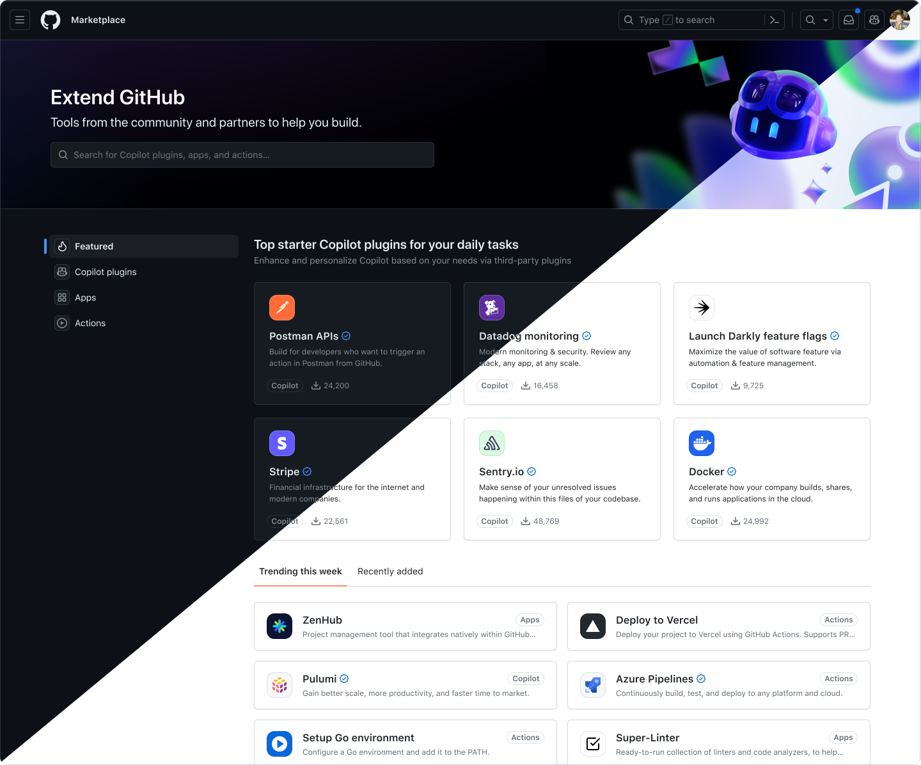
Accelerate productivity
Enhancing the Developer Experience
Copilot extensions (limited public beta)
Add functionality from preferred first- and third-party developer tools and services, such as Azure, Docker, Sentry, and more, or build your own to customize your organization’s GitHub Copilot experience.
Copilot Plugins Rendering
Notes:
Release Issue: Copilot Extensibility
Talk Track:
We're enhancing the GitHub Copilot experience with the introduction of Copilot extensions, currently in a limited public beta. This new feature allows you to integrate functionality from your preferred first- and third-party developer tools and services, such as Azure, Docker, Sentry, and others. The ability to add these tools or even build your own custom extensions provides a unique opportunity to tailor the GitHub Copilot experience specifically to your organization's needs.
By leveraging these extensions, you can streamline your development workflow, enhance productivity, and ensure that your team has all the necessary tools at their fingertips within a familiar environment. This customization not only boosts efficiency but also aligns Copilot's capabilities closely with your specific project requirements and security standards.

Slide 22
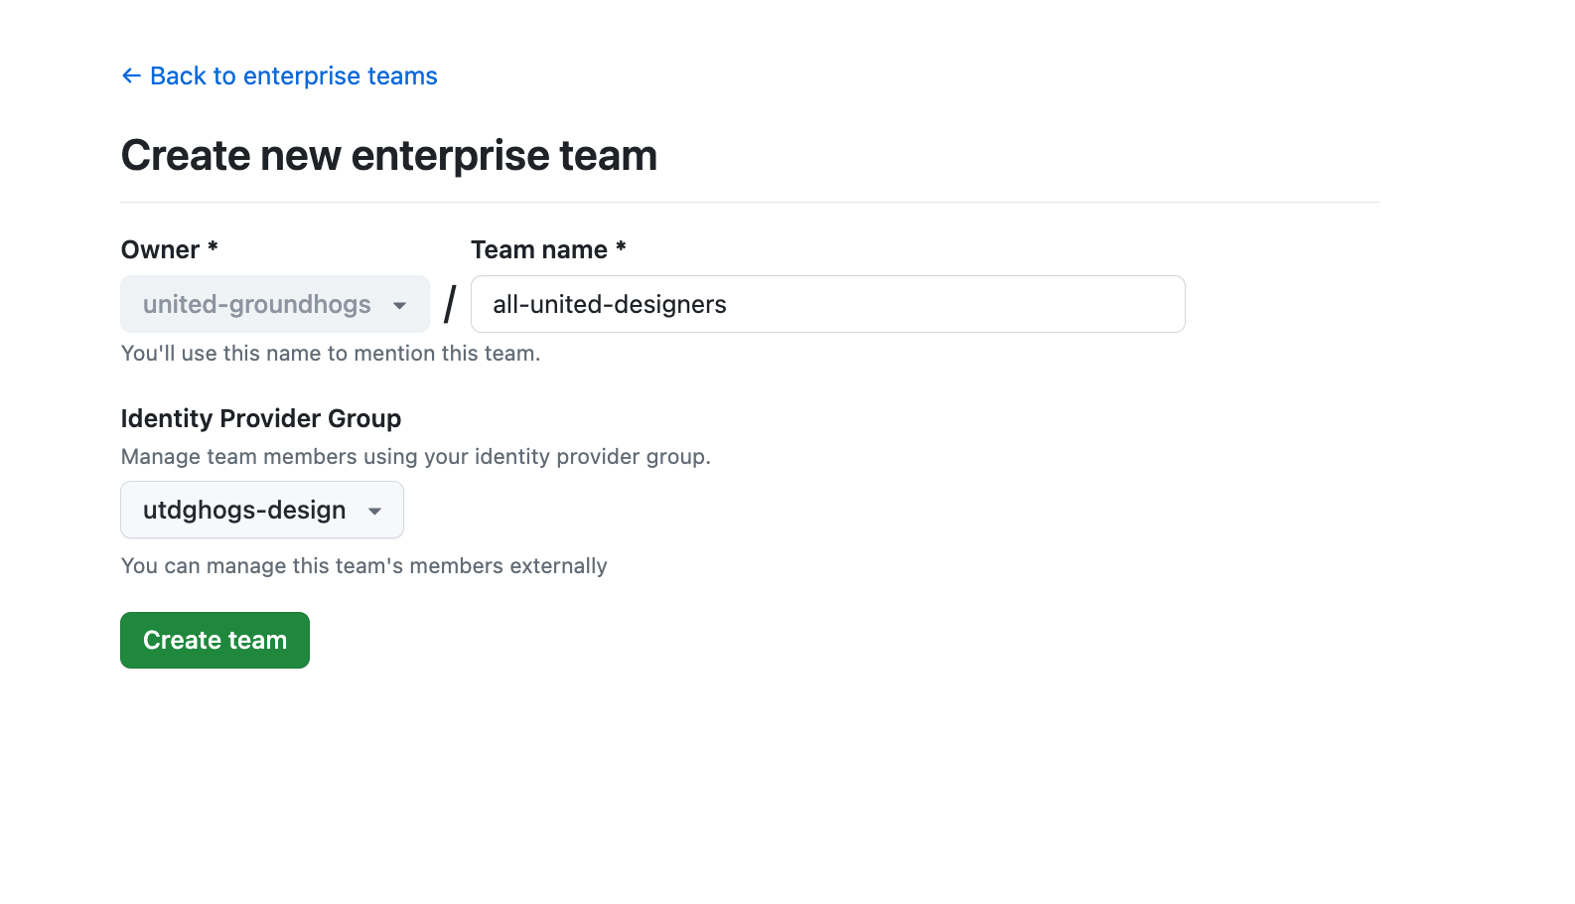
Flexible
Governance
Empowering Enterprises
Truly enterprise-first access & authz control
Scale granular access & permission management across a large enterprise, efficiently - through enterprise-level user & app management, including:
- Assign organization-wide roles (ex repo “read”)
- Create enterprise-level teams
- Install apps once across an enterprise
- Add enterprise collaborators from your IdP
Notes:
Release Issue: EMU Guest collaborators // Repository Collaborators
Talk Track: We are enhancing our enterprise-first access and authorization controls to efficiently manage granular permissions and access across large organizations. This includes robust features for enterprise-level user and application management such as assigning organization-wide roles, creating enterprise-level teams, installing apps across the entire enterprise, and adding collaborators directly from your Identity Provider (IdP).
Additionally, we support guest collaborators, facilitating flexible and managed collaboration with contractors and short-term partners. This feature allows for seamless sharing of code and ideas on specific projects without imposing the same restrictions faced by full enterprise members. These enhancements ensure that large enterprises can scale their operations effectively while maintaining strict control over access and permissions, optimizing both security and collaborative efforts.

Slide 23

Visibility
Empowering Enterprises
Granular billing controls and reports
Our new billing platform gives you much greater control and visibility into your company’s usage and spending, with:
Cost centers
Budgets & alerts
Usage reports
Notes:
Release Issue: Billing vNext
Talk Track: Billing vNext is an improved platform that has been specifically developed to offer customers greater transparency and administrative control by implementation of granular controls, which allow for a more streamlined and efficient experience for our customers, partners, and colleagues. This platform is designed to facilitate a frictionless onboarding process for new products, while also providing valuable insights that can be scaled over time.

Slide 24

Enterprise Grade AI
Empowering Enterprises
Copilot custom models (limited public beta)
Train a bespoke copilot that is personalized and private to your organization.
Coding suggestions based on your repositories
Enhanced gains on productivity, efficiency, and code quality
Notes:
Release Issue: Copilot Fine-tuning (Limited Public Beta)
[Outcome Lead In]
Enterprise-grade AI enhances the developer experience by automating complex tasks, providing intelligent insights, and streamlining workflows, which boosts productivity and allows developers to focus more on strategic and creative aspects of their projects.
Talk Track:
We’re enhancing the Copilot experience with custom models via features like fine-tuning, which allows you to customize your experience, using your own data. This development enables Copilot to provide more accurate and relevant code suggestions by learning directly from designated source code repositories. Additionally, it can offer better suggestions for proprietary or less commonly used programming languages not well-represented in public codebases. This customization extends to adhering to an organization's specific coding styles and conventions.
The design of this feature adheres to a privacy and security-first principle, ensuring that all aspects of the service—from hosting and inferencing of the custom model to its training—are kept secure and private for each organization. This focus on personalization not only makes Copilot more relevant to specific developer needs but also increases coding efficiency and reduces errors, effectively enhancing overall code quality while maintaining strict privacy standards.
Notes
Fine-tuning allows customers to use their own data to tailor their developers’ Copilot experience. This allows Copilot to:
Show more relevant code suggestions learned from designated source code repositories.
Show more relevant code suggestions for proprietary or less representative programming languages (in public code).
Show code suggestions tailored according to org's specific coding style or convention.
And with a privacy & security first product design principle, the product values for customers can be summarized as:
Personalization - Copilot becomes even more personalized to show more relevant and tailored code suggestions beyond conventional approaches (i.e. prompt crafting, Retrieval Augmented Generation or RAG)
Efficiency & Quality - Developers can write code faster and with fewer errors
Private inferencing - The custom model’s hosting & inferencing are secured and kept private for the customer. The model’s training process is also completely secure & private to the customer.

Slide 25


Enterprise Grade AI
Empowering Enterprises
Mixed Copilot licensing
For large enterprises, choose between Copilot Business and Copilot Enterprise licenses by organization.
Notes:
Release Issue: Mixed Licensing for CE & CB
Talk Track:
We want to significant enhancement to how enterprises can manage their GitHub Copilot subscriptions. Previously, enterprises faced a decision: opt for either Copilot Business or Copilot Enterprise for all their organizations. Now, with this update, GitHub Enterprise Cloud (GHEC) customers gain the ability to select a specific Copilot plan for each organization within their enterprise. This change offers unprecedented purchasing flexibility, allowing enterprises to tailor their tooling and investment to the unique needs of each organization, enhancing their ability to manage costs effectively while maximizing utility across different teams. This strategic flexibility is key in providing the right tools for every team, ensuring that all parts of the enterprise are equipped to succeed.

Slide 26
Thank You!

